Slide 1
Visualizations

Slide 2
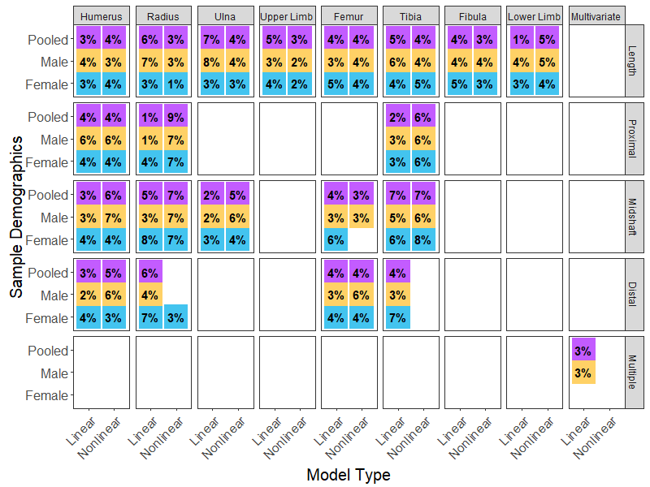
Visualizing Data
Data visualization is the presentation of data in a pictorial or graphic format
Faster interpretation over spreadsheets or multi-page reports
Easy pattern recognition / identification

Slide 3
Data Visualization Tips
There are a few basic concepts that can help you generate the best visuals for displaying your data:
Understanding the data – size and cardinality (uniqueness)
Determining what you are trying to visualize – what you want to communicate
Knowing your audience – what type of visualization will be easiest to process?

Slide 4
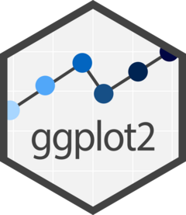
ggplot2
library(ggplot2)
Most robust and versatile
Based on the “Grammar of Graphics”
Plots are built up in layers

Slide 5
Ingredients of a Plot
Data
Mappings: maps variables to plot elements
Geometrics: points, lines, boxes, histogram, bars, etc.
Scales: controls the mapping of the values in the data space to values in the aesthetic space
Guides: controls how visual properties are mapped back to the data space
Labels: axis, legend, titles
Themes: visual themes for the plot

Slide 6
The Big 3
Only 3 ingredients are necessary to make a plot:
Data
Mapping / Aesthetics
A “geom”
> ?ggplot()
ggplot(data = NULL, mapping = aes(), ..., environment = parent.frame())

Slide 7
1. Data
Always begin with the main function in ggplot2: ggplot()
Data are specified via the “data” argument:
> ggplot(data = mydata)
This argument provides a coordinate system to add layers to

Slide 8
2. Aesthetics
aes() maps variables from a data set to various elements of a plot → where the points/data should go
Discrete values (groups/categories) can have color, shape, linetype, or fill mappings
Points additionally can have x and y position mappings
Mappings go into the aes() function as the second argument in ggplot()
> ggplot(data=df, aes(x=V1, y=V2, color=V3))
Any part of the plot related to the data goes in aes()

Slide 9
3. “geoms”
“geoms” are the type of geometrics in your plot
Common “geoms” include:
_boxplot()
_histogram()
_line()
_density()
_bar()
_point()

Slide 10
IMPORTANT
ggplot() is built in layers
Use the + operator to add layers to the existing ggplot() object
In this way, your code is explicit about which layers are added and in what order
> ggplot(data=mydata, aes(x=V1, y=V2, color=V3)) + geom_point()

Slide 11
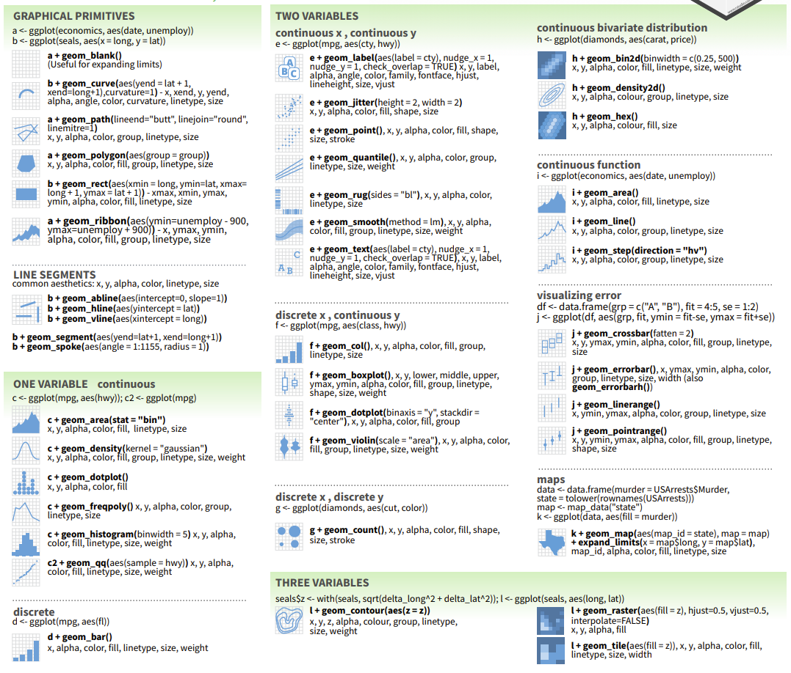
What Kind of Data Do You Have?
Different Data Types have Different Visualization Options

Slide 12
Making the Plot an Object
To build your plots layer by layer, you use a continuous combination of geoms:
> ggplot(mydata, aes(x, y)) + geom_point() + geom_line()
OR you can add plot elements layer by layer to an object
> my_plot <- ggplot(df, aes(x, y))
> my_plot <- my_plot + geom_point()
> my_plot <- my_plot + geom_line()

Slide 13
Printing Your Plots
You do not need to create an object for the plot
> ggplot(data=df, aes(x=V1, y=V2, color=V3)) + geom_point()
BUT you can assign your plot to a variable…
> my_plot <- ggplot(df, aes(x, y)) + geom_point()
… and then print / view your plot
> my_plot

Slide 14
Building Common Visualizations

Slide 15
Boxplots
Visualize the distribution of continuous variables by plotting its five-number summary:
Minimum
25th percentile
Median (50th percentile)
75th percentile
Maximum
y = Continuous Variable
x = Discrete Variable

Slide 16
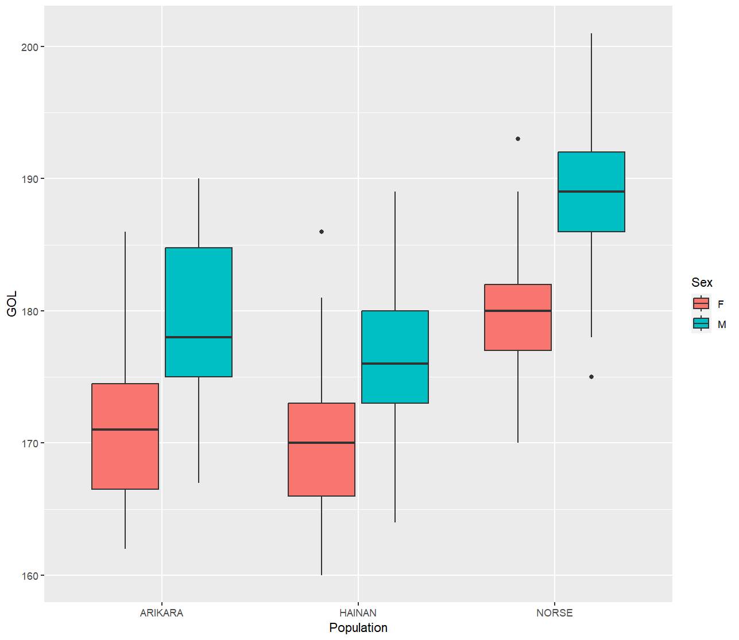
Boxplots
Boxplots are useful for:
Comparing groups
Displaying outliers

Slide 17
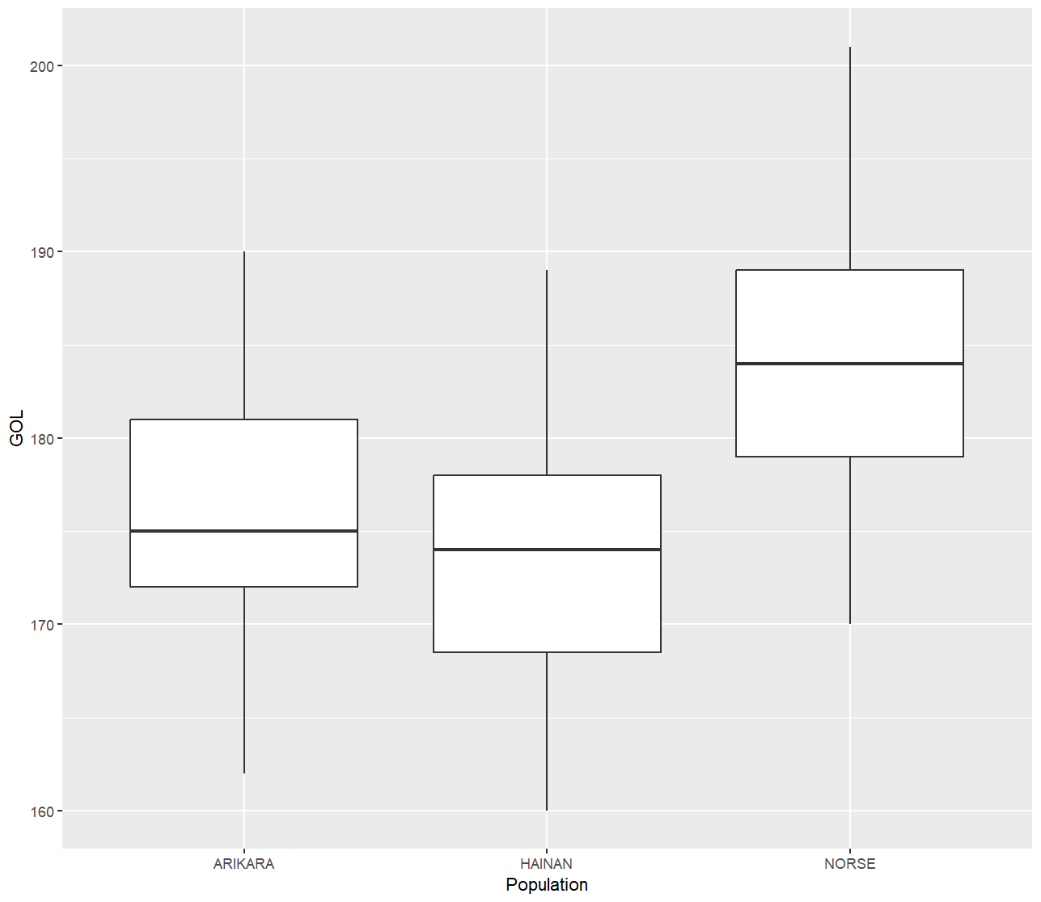
Boxplots
One continuous variable (y-axis), one discrete variable (x-axis)
> gol <- howells[
howells$Population==‘ARIKARA’ | howells$Population==‘HAINAN’ | howells$Population==‘NORSE’, ]
> ggplot(gol, aes(x=Population, y=GOL)) + geom_boxplot()

Slide 18
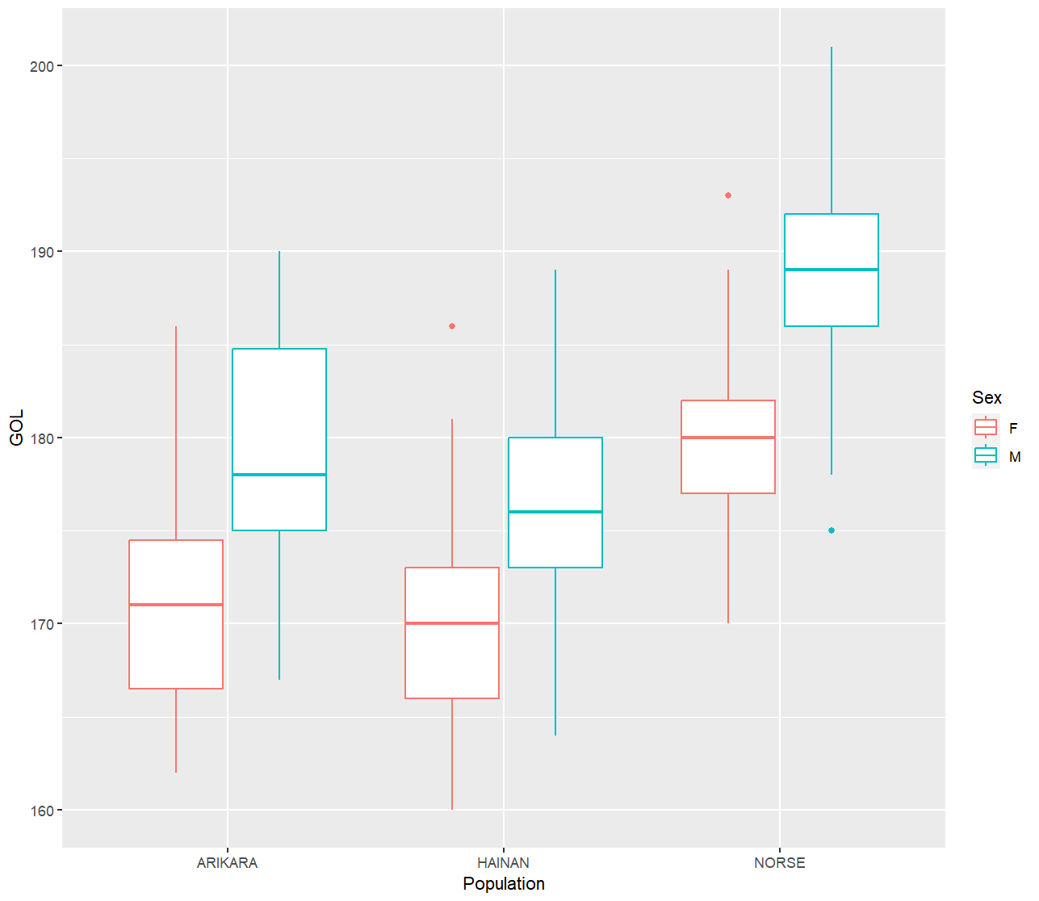
Boxplots: Discrete Colors
Discrete variables can also be used to differentiate plot elements by including in the aes() function
> ggplot(gol, aes(x=Population, y=GOL, color=Sex)) + geom_boxplot()

Slide 19
Boxplots: Discrete Fill
Discrete variables can also be used to differentiate plot elements by including in the aes() function
> ggplot(gol, aes(x=Population, y=GOL, fill=Sex)) + geom_boxplot()

Slide 20
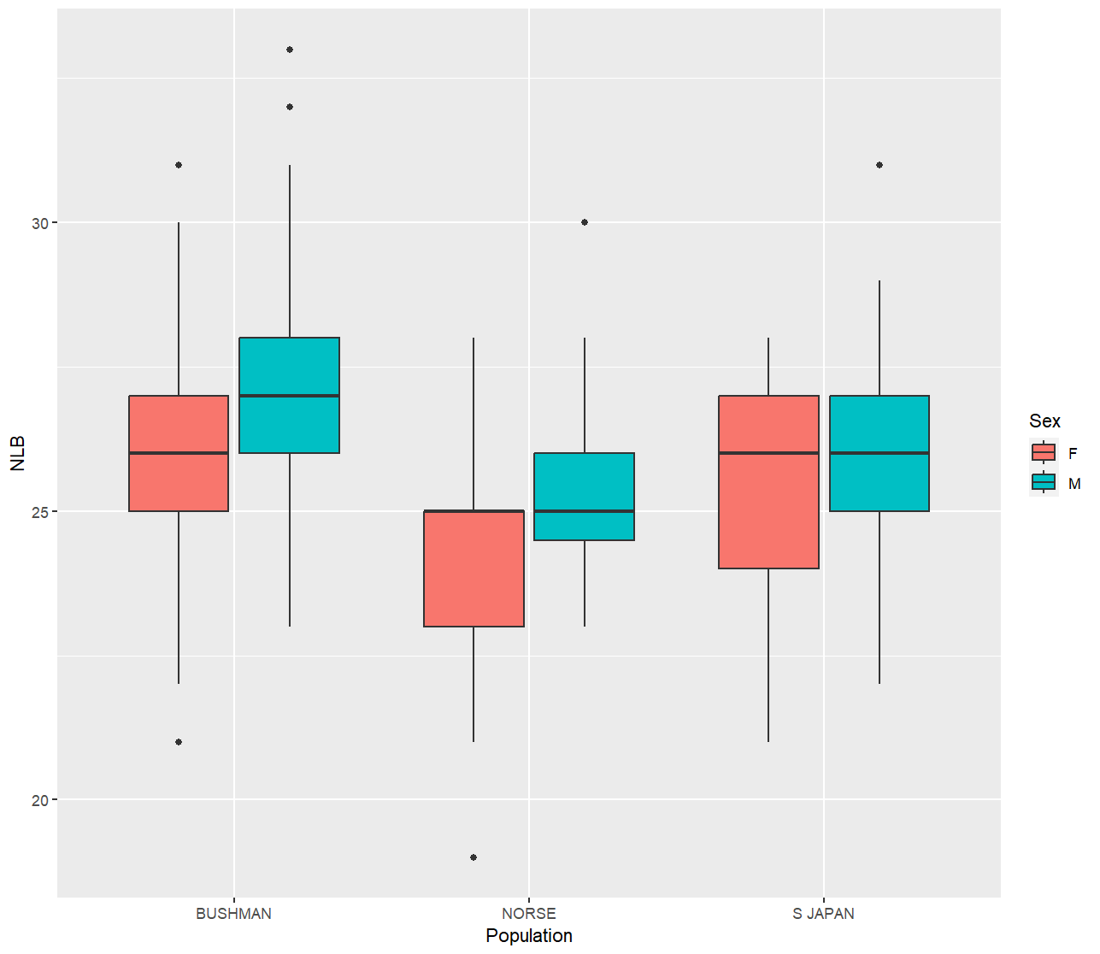
Practice
With the following data:
> nlb <- howells %>% select(Sex, Population, NLB) %>% filter(Population %in% c("NORSE", "BUSHMAN", "S JAPAN")) %>% na.omit()
Produce this plot

Slide 21
Answer
> ggplot(nlb, aes(x=Population, y=NLB, fill=Sex)) + geom_boxplot()
OR
> ggplot(nlb, aes(x=Population, y=NLB)) + geom_boxplot(aes(fill=Sex))

Slide 22
Histograms, Density Plots, and Bar Plots
Displays the distribution of one vector (column) from your data

Slide 23
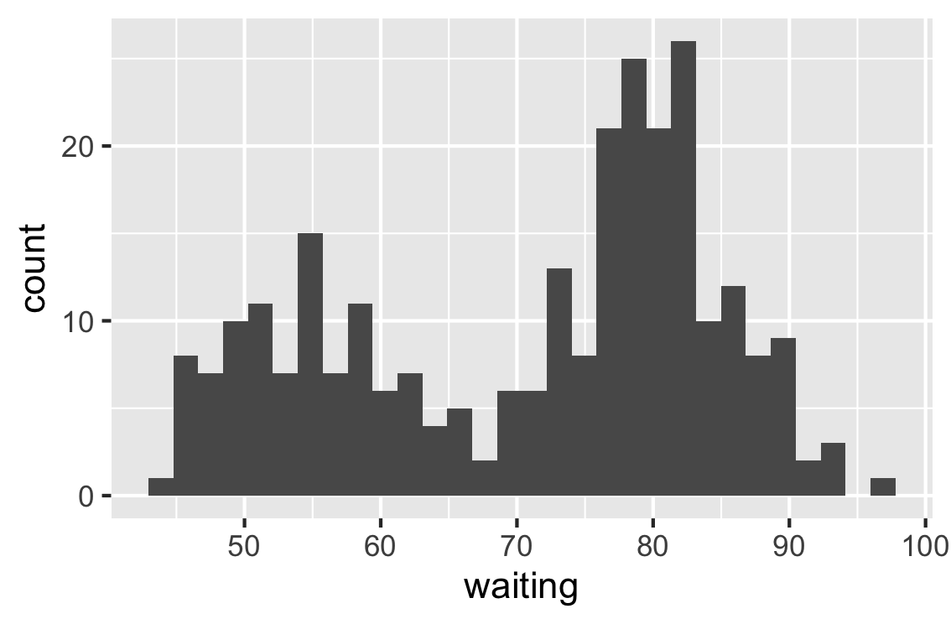
Histograms
> ggplot(faithful, aes(x=waiting)) + geom_histogram()
Faithful is in R. Just type faithful in the console
Divides the range of scores into a specified number of “bins” on the x-axis and displays the count on the y-axis
Used to plot continuous data

Slide 24
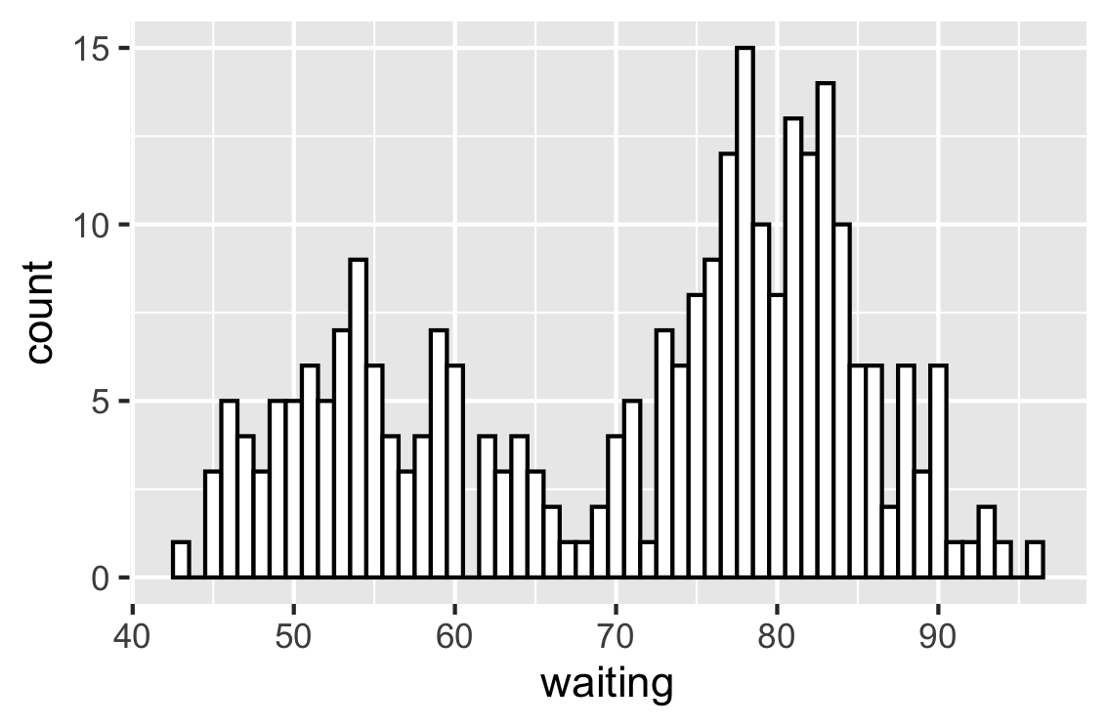
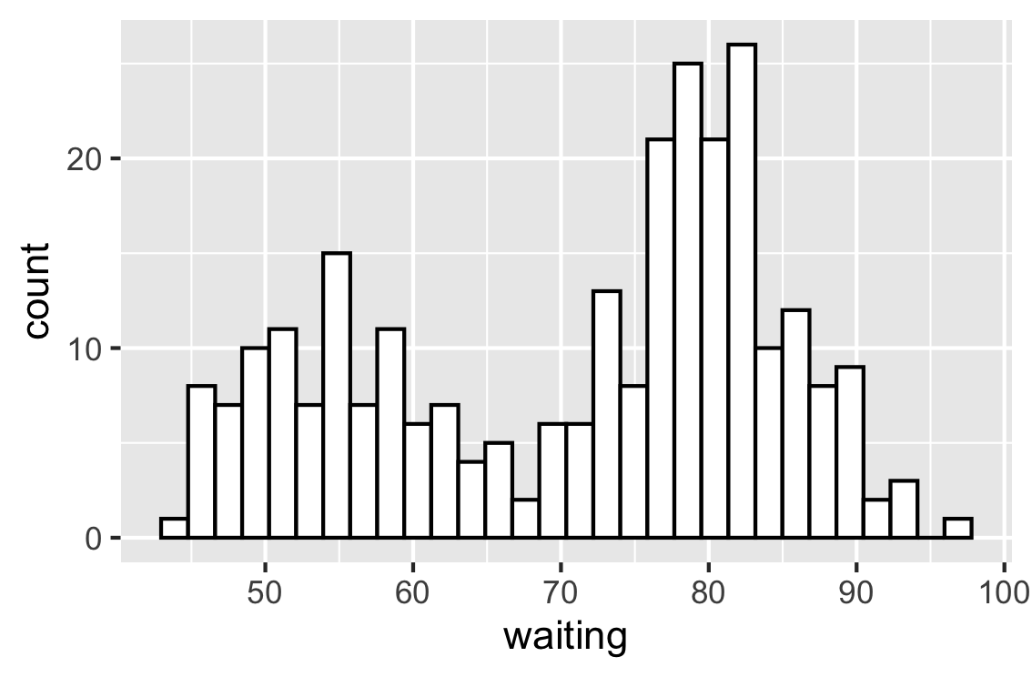
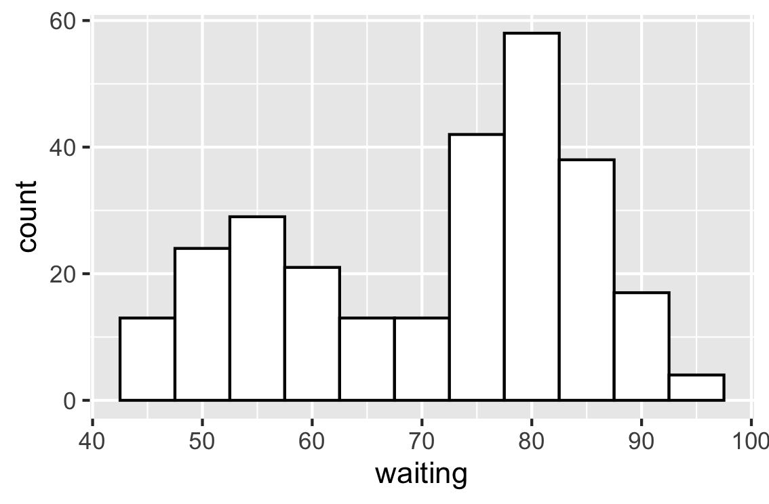
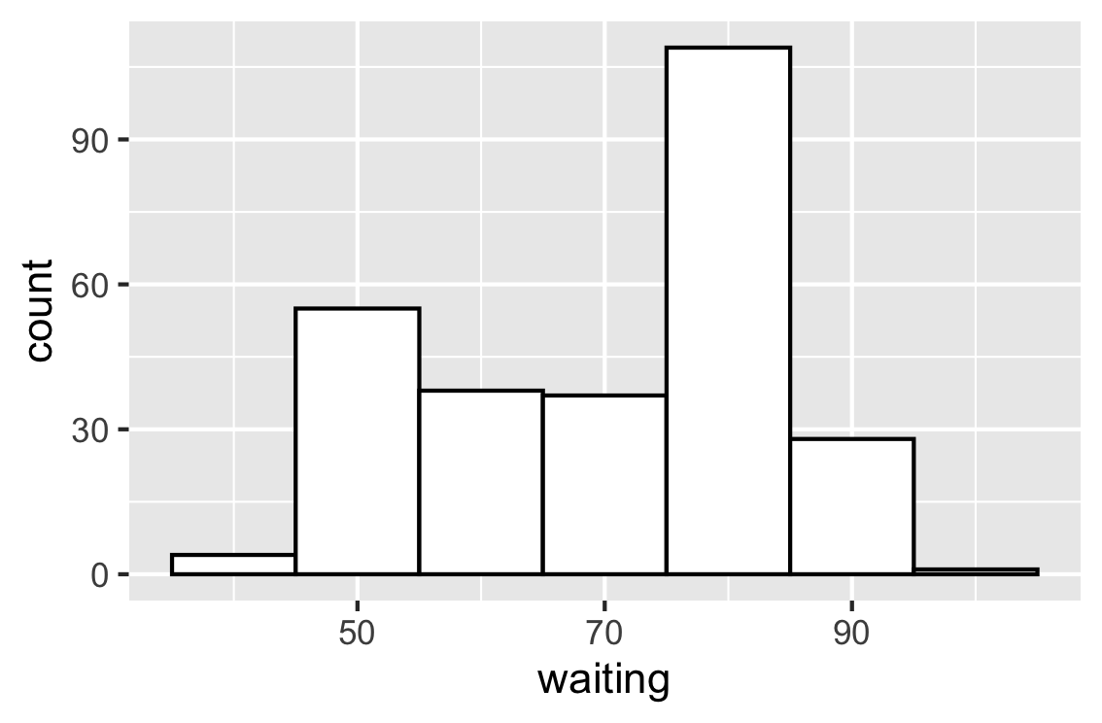
Histograms: binwidth, fill, and color
> ggplot(faithful, aes(x=waiting)) + geom_histogram(binwidth=5, fill="white", color="black")
binwidth=1
default
binwidth=10

Slide 25
Histograms: faceting
facet_grid() separates (“facets”) the plot by rows, columns, or both.
General format: ROWS ~ COLS
NOTE: [.] means “not in this dimension”
> ggplot(pop, aes(x=age_y)) + geom_histogram(fill="black”, colour="white”) + facet_grid(popsex ~ .) + labs(x="Age (years)", y="Count”) + scale_x_continuous(breaks=c(0,10,20)) + mytheme

Slide 26
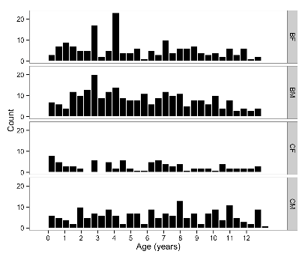
Histograms: faceting
> ggplot(pop, aes(x=age_y)) + geom_histogram(fill="black”, colour="white”) + facet_grid(popsex ~ .) + labs(x="Age (years)", y="Count”) + scale_x_continuous(breaks=c(0,10,20)) + mytheme

Slide 27
Histograms: faceting
> ggplot(pop, aes(x=age_y)) + geom_histogram(fill="black”, colour="white”) + facet_grid(popsex ~ .) + labs(x="Age (years)", y="Count”) + scale_x_continuous(breaks=0:12) + mytheme

Slide 28
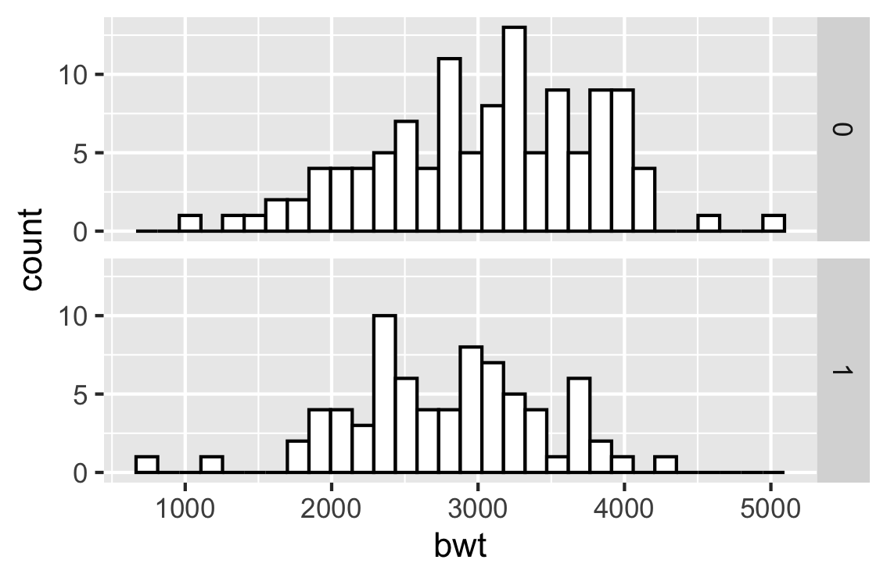
Practice
Produce this plot
The `birthwt` dataset can be accessed by running:
> library(MASS)
> data(birthwt)
Inspect the dataset using ??birthwt
1. What does `lwt` stand for?

Slide 29
Answer
> ggplot(birthwt, aes(x=bwt)) + geom_histogram(fill="white", color="black") + facet_grid(smoke~.)
> ggplot(birthwt, aes(x=bwt)) + geom_histogram(fill="white", colour="black") + facet_grid(rows=vars(smoke))
> ggplot(birthwt) + geom_histogram(aes(x=bwt), fill="white", colour="black") + facet_grid(rows=vars(smoke))

Slide 30
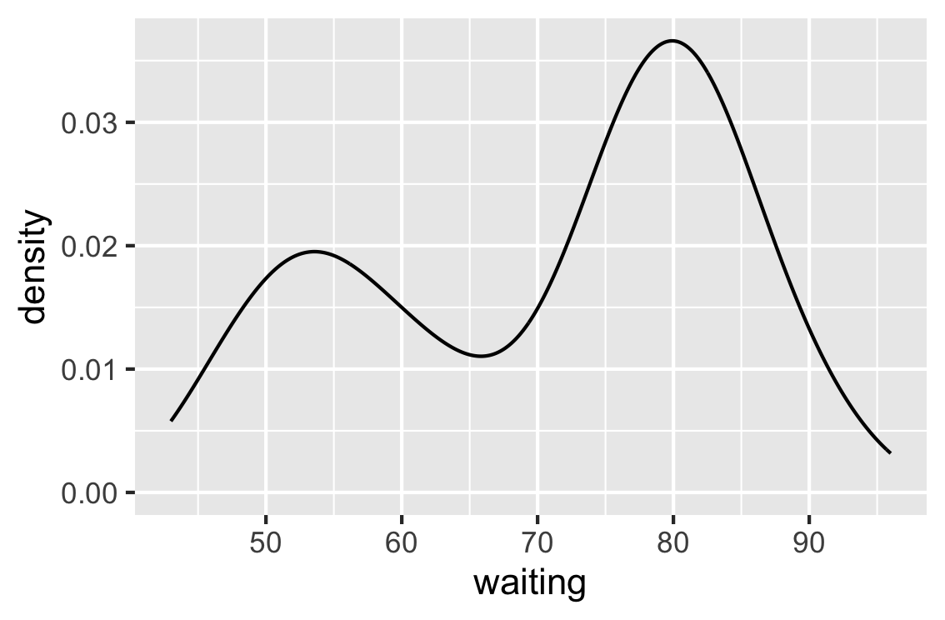
Density Plots
> ggplot(faithful, aes(x=waiting)) + geom_density()
“Nonparametric method for estimating the probability density function of a random variable”
AKA it gives you the proportion instead of the count
Results in a smoothed line
Used to plot continuous data

Slide 31
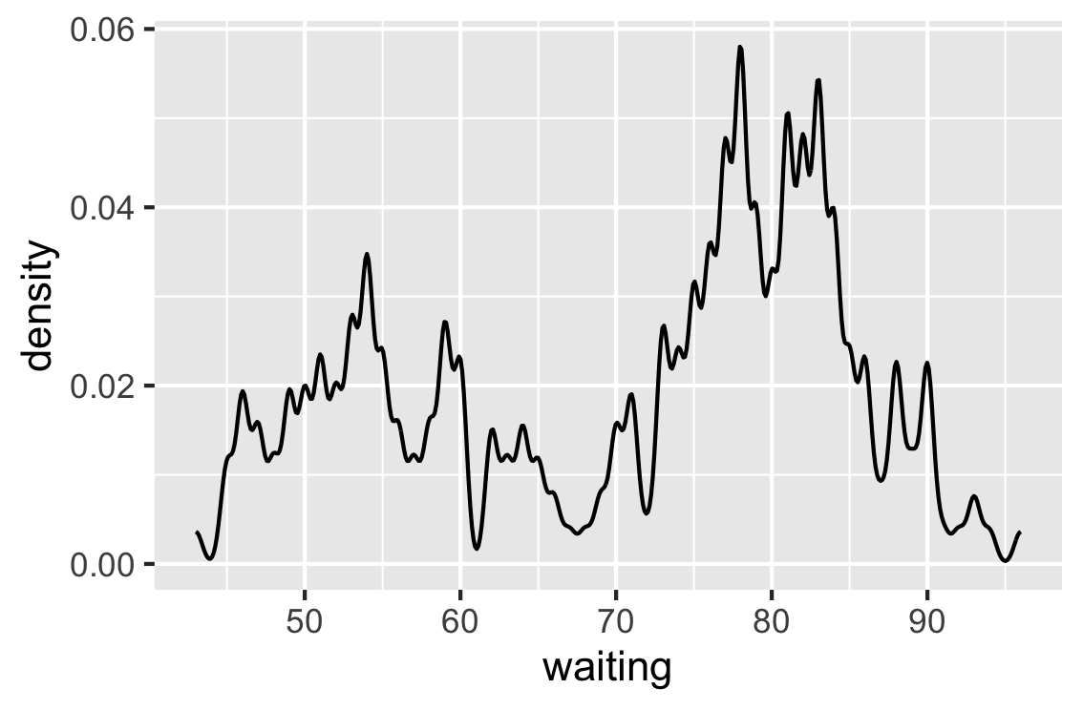
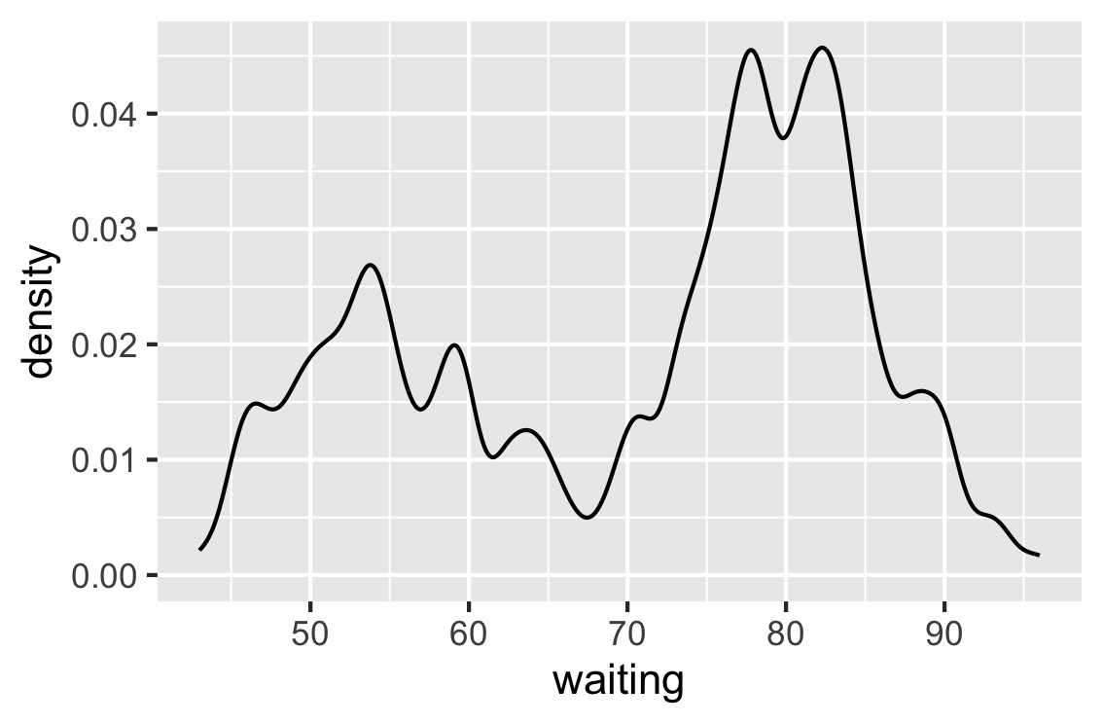
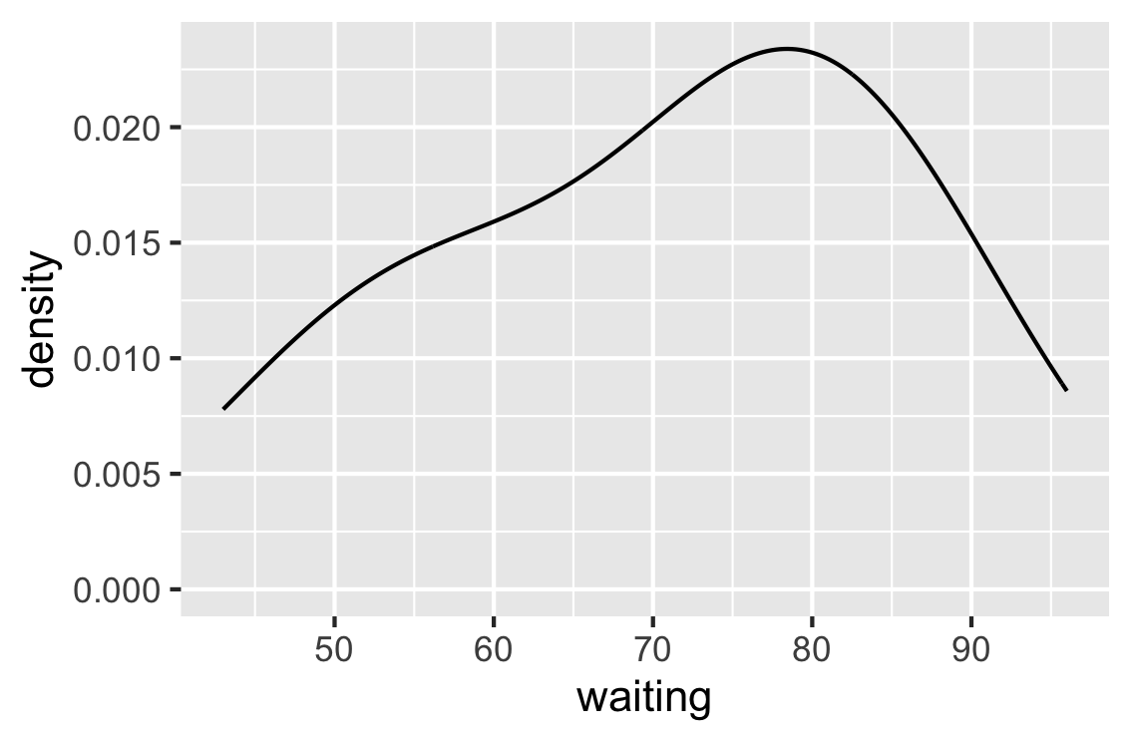
Density Plots: sensitivity
> ggplot(faithful, aes(x=waiting)) + geom_density(adjust=0.25)
adjust=0.1
default
adjust=2.5

Slide 32
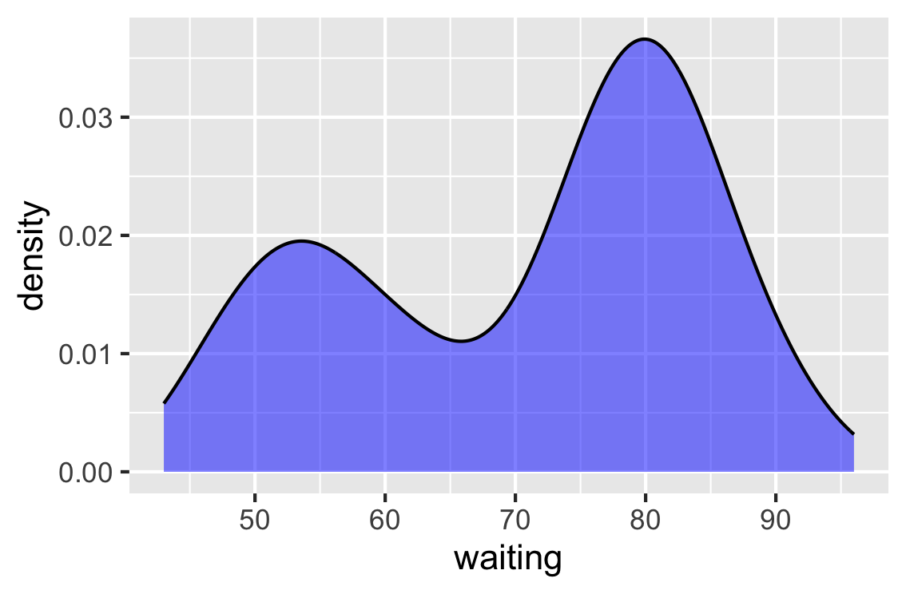
Density Plots: fills
> ggplot(faithful, aes(x=waiting)) + geom_density(fill="blue", alpha=0.5)
geom_density() can be filled with a color.
NOTE: alpha is used to indicate transparency
0 == transparent
1 == opaque

Slide 33
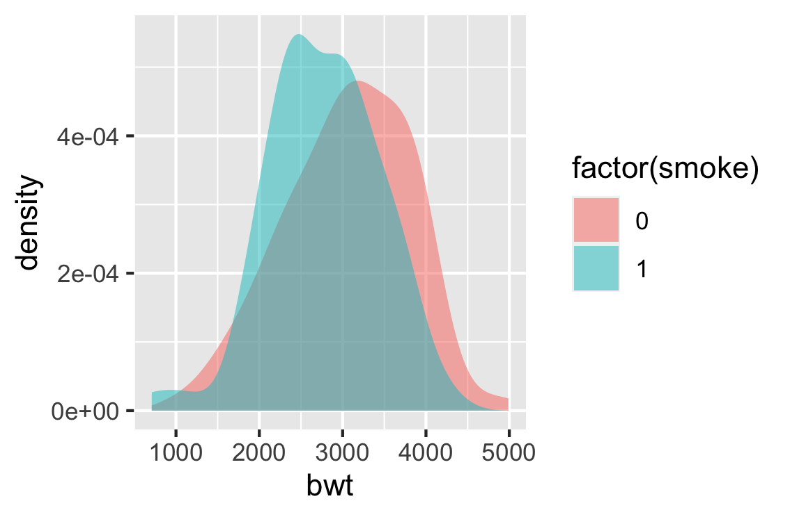
Density Plots: Factors
> ggplot(birthwt, aes(x=bwt, fill=factor(smoke))) + geom_density(color=NA, alpha=0.5)
Just like other plots we have seen, a discrete variable (factor) can be used to separate groups

Slide 34
RECALL
ggplot() is built in layers
Use the + operator to add layers to the existing ggplot() object
In this way, your code is explicit about which layers are added and in what order
> ggplot(data=df, aes(x=V1, y=V2, color=V3)) + geom_point()
You can stack different geom_* layers on top of each other to include in a single plot

Slide 35
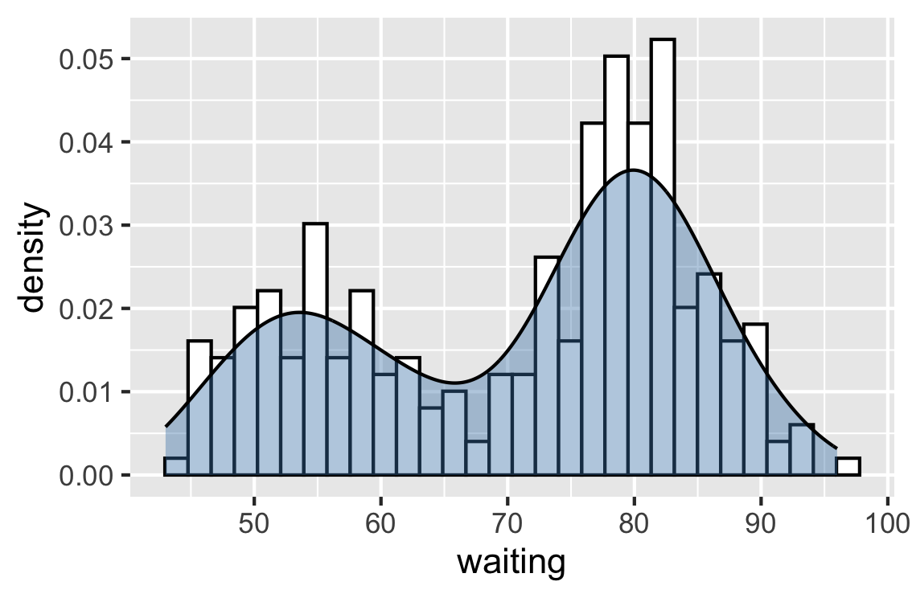
Practice
Produce this plot using the faithful dataset
Hints:
faithful dataset
You will need to use 2 geoms
Use y=after_stat(density) in your aes() to scale the histogram so that it matches the density plot
Use steelblue as your color and alpha=0.4
Remember that plots are built in layers

Slide 36
Answer
> ggplot(faithful, aes(x=waiting, y=after_stat(density))) +
geom_histogram( fill="white", color="black") + geom_density(fill="steelblue", alpha=0.4)
NOTE: because the density curve values range from 0 to 1 (as a proportion), we use y=after_stat(density) to scale the histogram’s y-axis to match the density plot

Slide 37
RECAP
What package do we use to create our plots?
What are the 3 main features to make the most basic plot?
What kind of data are represented by a histogram?
How would you create a boxplot using the Howell’s dataset, with Sex on the x-axis and boxplots filled by Population?

Slide 38
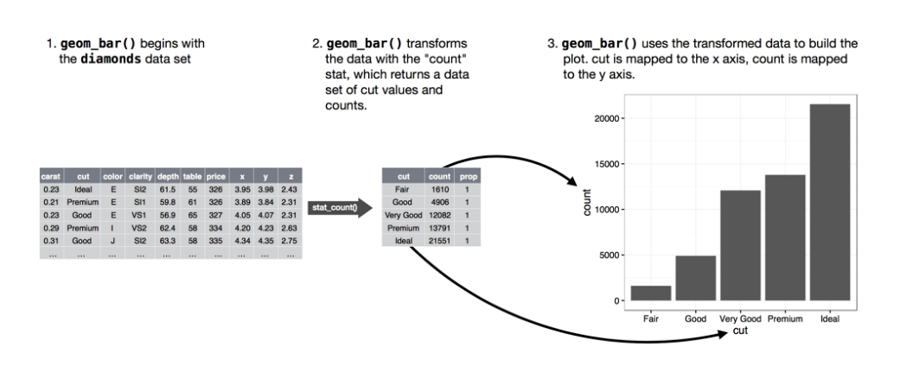
Bar Plots
Displays the amount (counts) of discrete / ordinal values
> ggplot(diamonds, aes(x=cut)) + geom_bar()

Slide 39
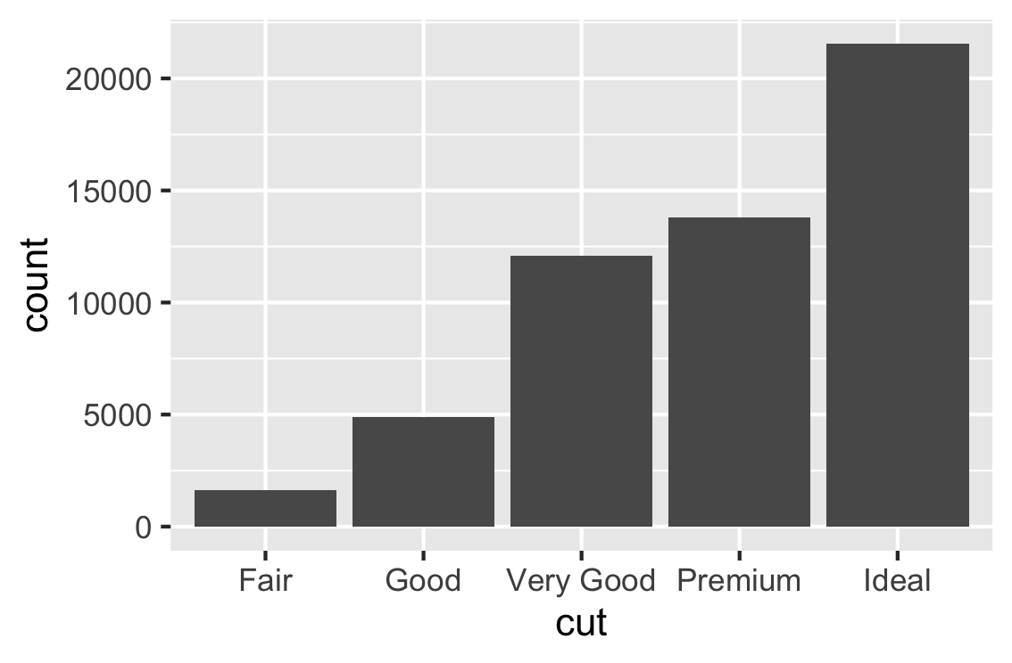
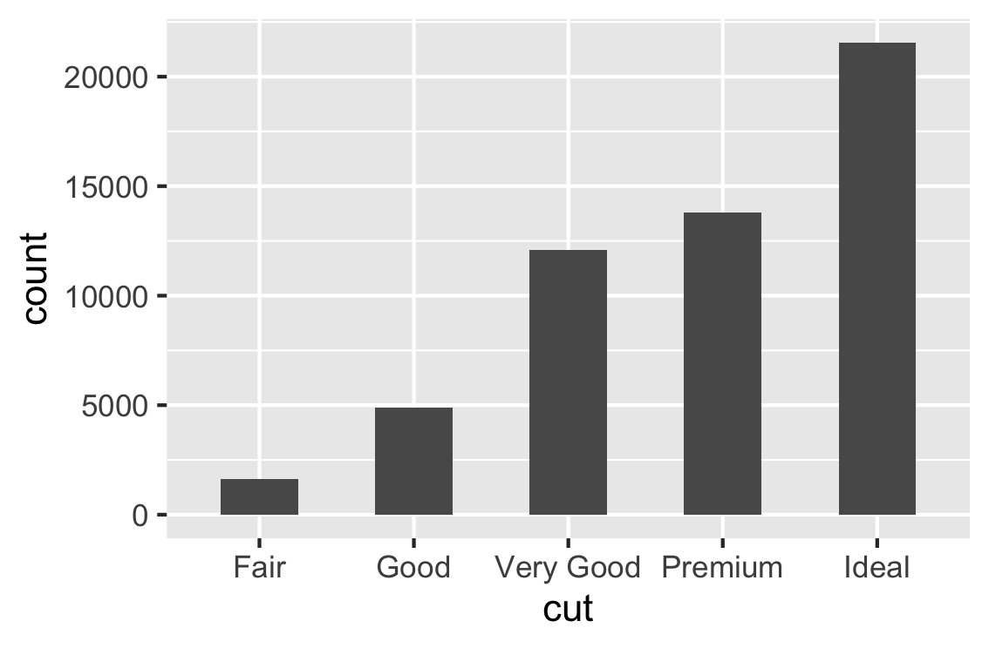

Bar Plots: bar width
default
width=0.5
width=1

Slide 40
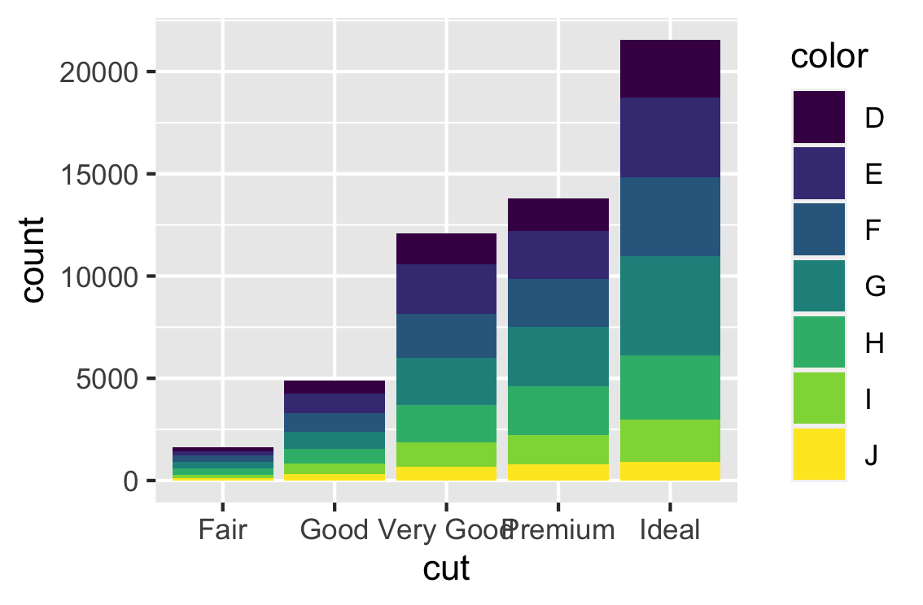
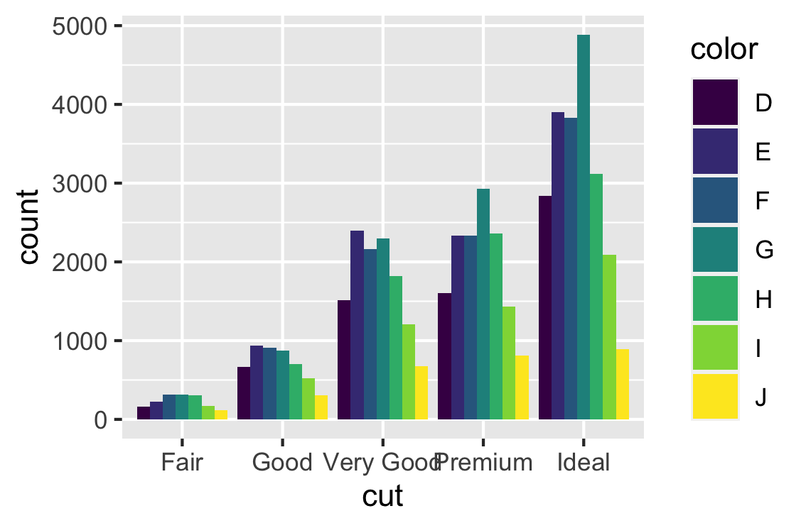
Bar Plots: Factors
Diamonds is in tidyverse. Remember library(tidyverse) and then you can access diamonds.
> ggplot(diamonds, aes(x=cut, fill=color)) + geom_bar()
> ggplot(diamonds, aes(x=cut, fill=color)) + geom_bar(position="dodge")

Slide 41
Line Plots
Visualizes how one variable on the y-axis changes in relation to changes in the x-axis
Can represent discrete(categorical) or continuous(numeric) variables on the x-axis***

Slide 42
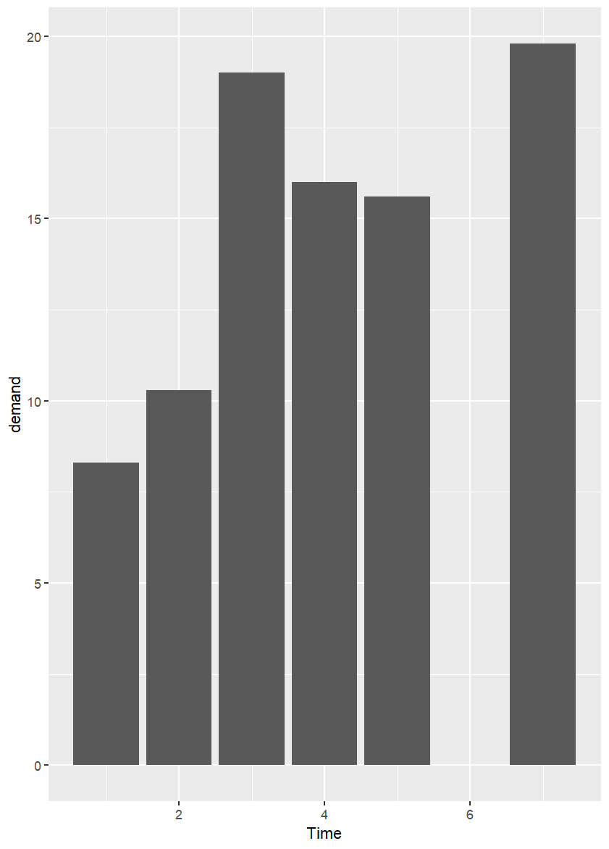
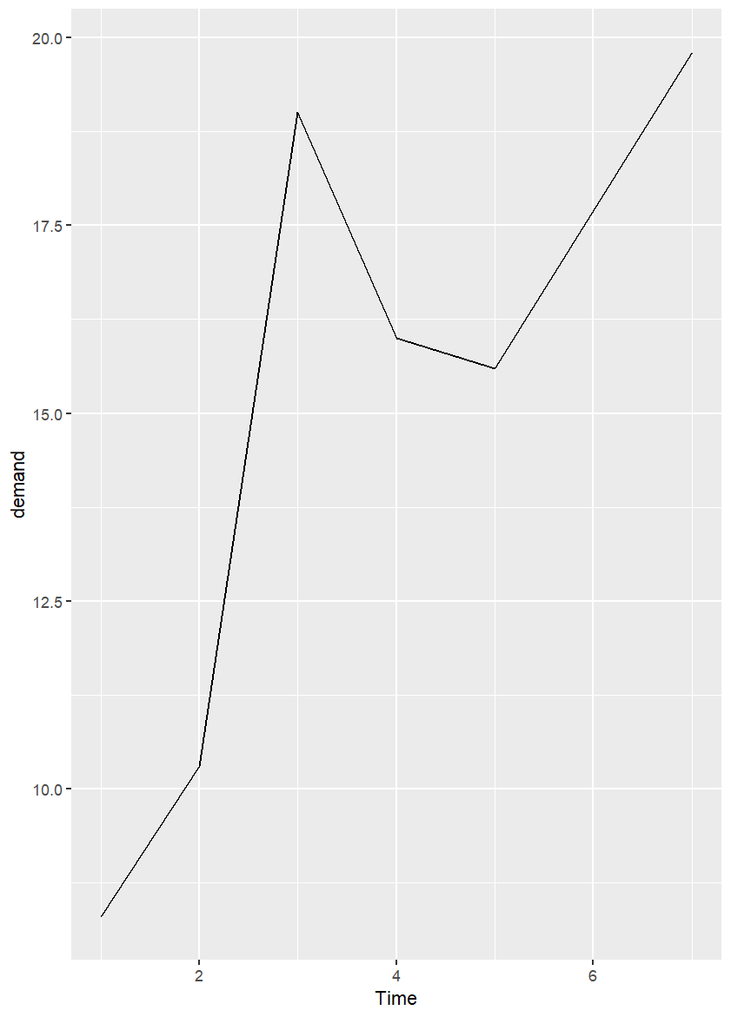
Line Plots
BOD is in R. Just type BOD in the console
We might want to represent data with lines instead of bars
ggplot(BOD, aes(x=Time, y=demand))
+ geom_col()
+ geom_line()
Time | Demand
1 | 8.3
2 | 10.3
3 | 19.0
4 | 16.0
5 | 15.6
7 | 19.8

Slide 43
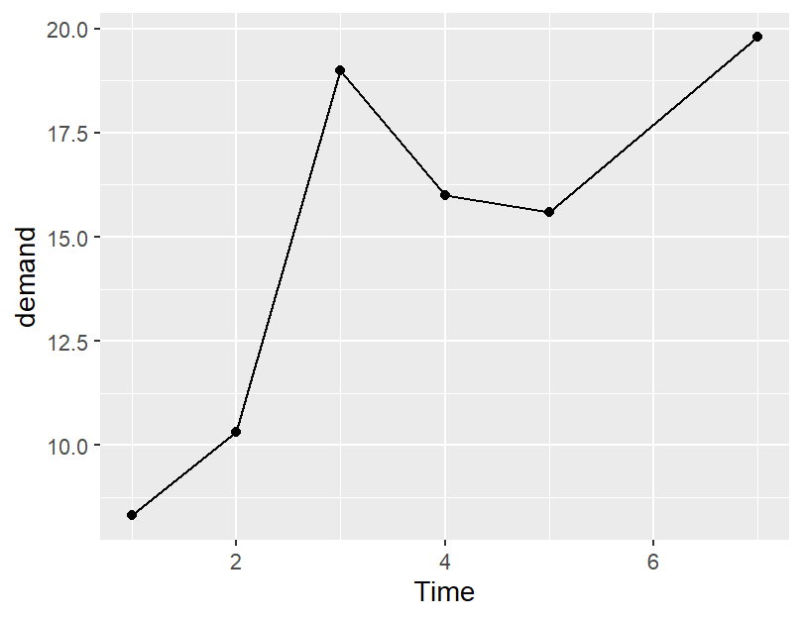
geom_line() + geom_point()
Sometimes adding points makes the line plots easier to interpret
ggplot(BOD, aes(x=Time, y=demand))
+ geom_line() + geom_point()

Slide 44
Changing Line Type
Line type is changed using the lty argument within geom_line() and can be specified by number or name:
“blank” or 0
“solid” or 1
“dashed” or 2
“dotted” or 3
“dotdash” or 4
“longdash” or 5
“twodash” or 6

Slide 45
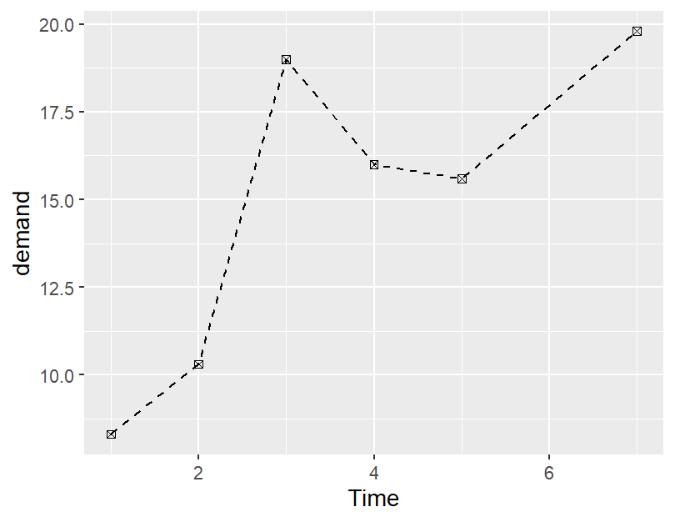
Changing Point Characters
Like lty in geom_line(), pch is used to change the point character for geom_point()
> ggplot(BOD, aes(x=Time, y=demand)) + geom_line(lty=2) + geom_point(pch=7)
More on this later, with scatter plots

Slide 46
Adding Complexity using Line Type
> data("ToothGrowth")
> head(ToothGrowth)
# A tibble: 6 × 3
# Groups: dose [3]
dose supp len
<dbl> <fct> <dbl>
1 0.5 OJ 13.2
2 0.5 VC 7.98
3 1 OJ 22.7
4 1 VC 16.8
5 2 OJ 26.1
6 2 VC 26.1
ToothGrowth is in R.

Slide 47
Adding Complexity using Line Type
ggplot(ToothGrowth, aes(x=dose, y=len, lty=supp)) + geom_line()
> data("ToothGrowth")
> head(ToothGrowth)
# A tibble: 6 × 3
# Groups: dose [3]
dose supp len
<dbl> <fct> <dbl>
1 0.5 OJ 13.2
2 0.5 VC 7.98
3 1 OJ 22.7
4 1 VC 16.8
5 2 OJ 26.1
6 2 VC 26.1

Slide 48
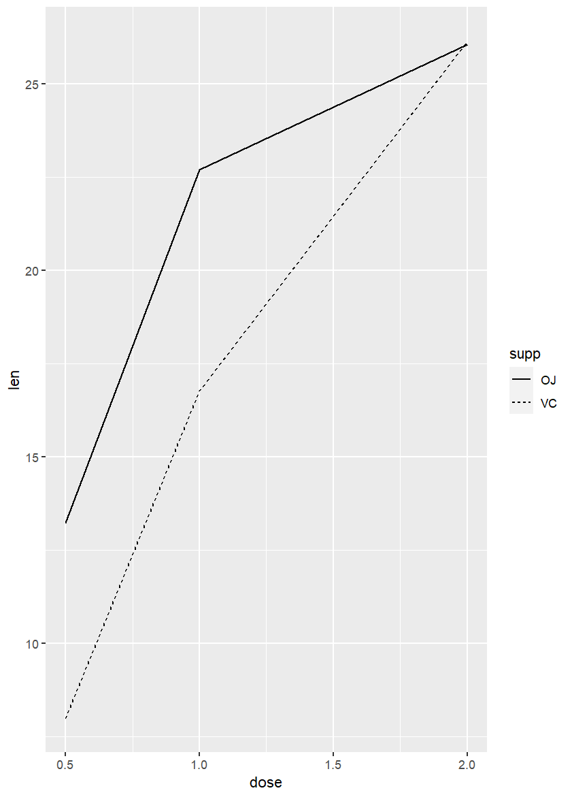
Adding Complexity using Line Type
ggplot(ToothGrowth, aes(x=dose, y=len, lty=supp)) + geom_line()
> head(tg)
# A tibble: 6 × 3
# Groups: dose [3]
dose supp len
<dbl> <fct> <dbl>
1 0.5 OJ 13.2
2 0.5 VC 7.98
3 1 OJ 22.7
4 1 VC 16.8
5 2 OJ 26.1
6 2 VC 26.1

Slide 49
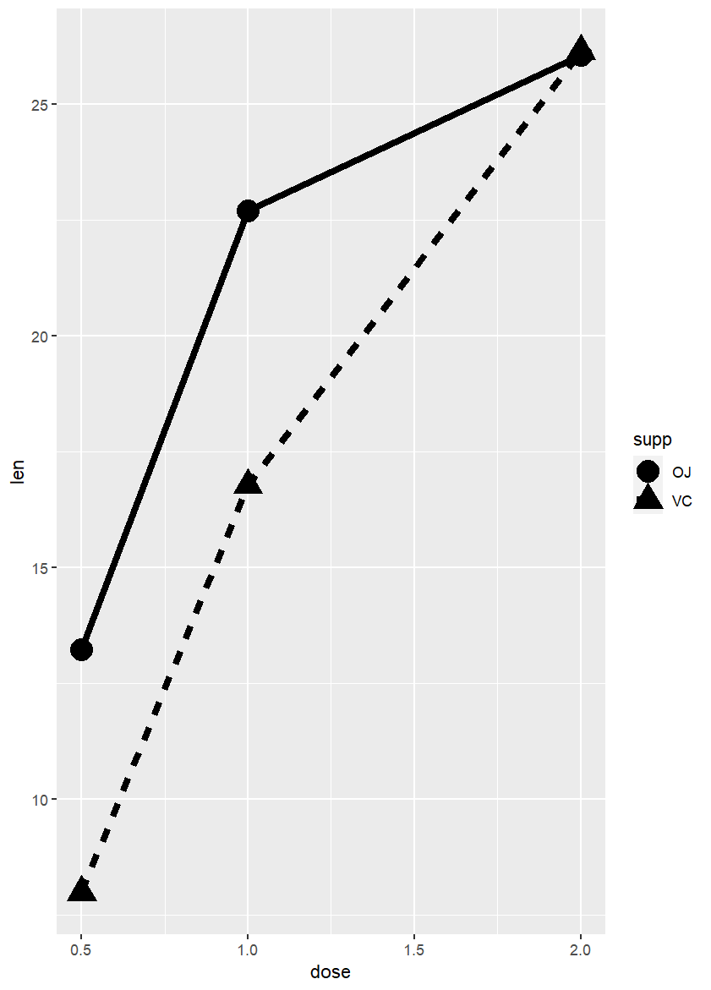
Changing Size
Line width is specified using lwd
Point size is specified with size
> ggplot(tg, aes(x=dose, y=len, shape=supp, lty=supp)) + geom_line(lwd=2) + geom_point(size=6)

Slide 50
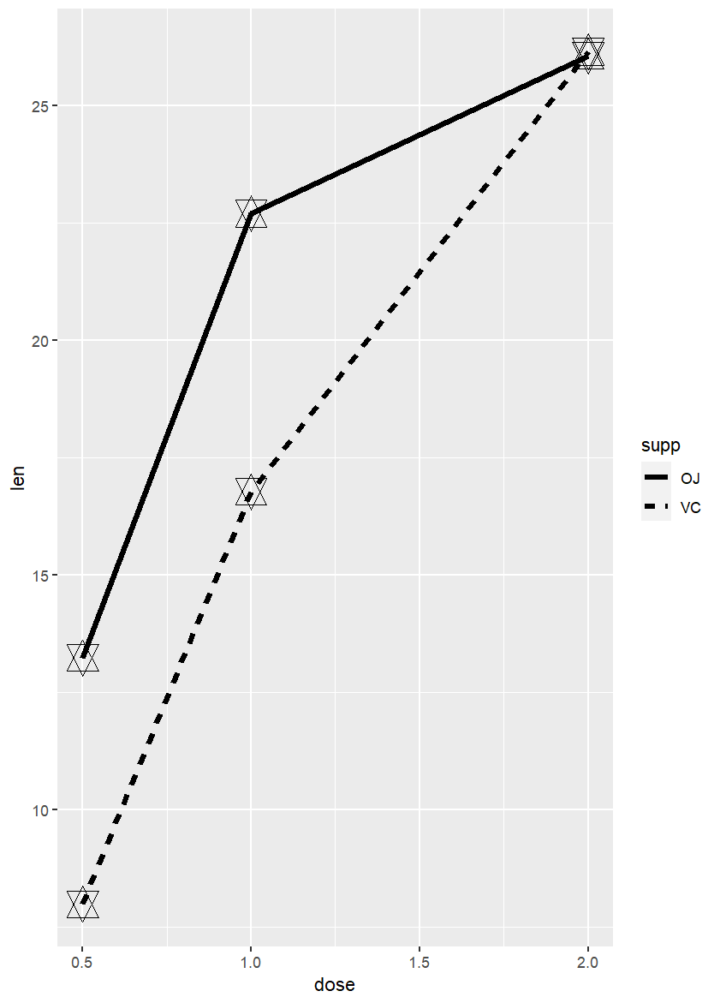
Practice
Produce this plot
Use the following code to transform your data:
tg <- ToothGrowth %>% group_by(dose, supp) %>% summarize(len = mean(len))
Hints:
Use help(pch) to find the correct pch value
Line width is 1.5 and point size is 6

Slide 51
Answer
> ggplot(tg, aes(x=dose, y=len, lty=supp)) +
geom_line(lwd=1.5) +
geom_point(size=6, pch=11)

Slide 52
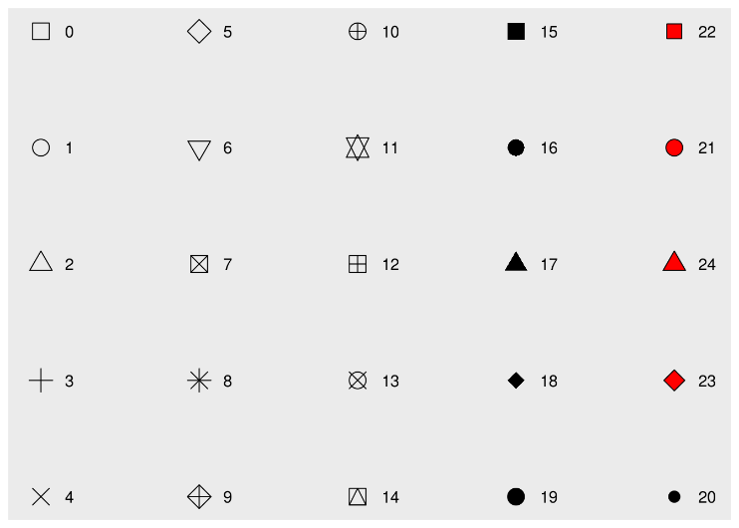
Points

Slide 53
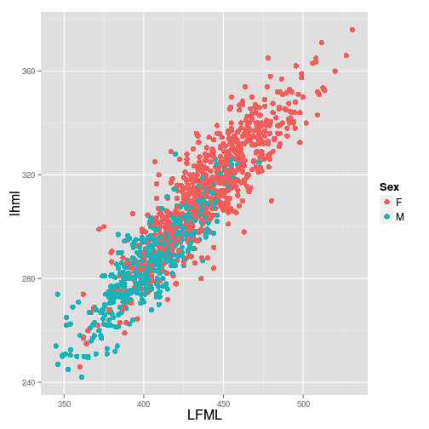
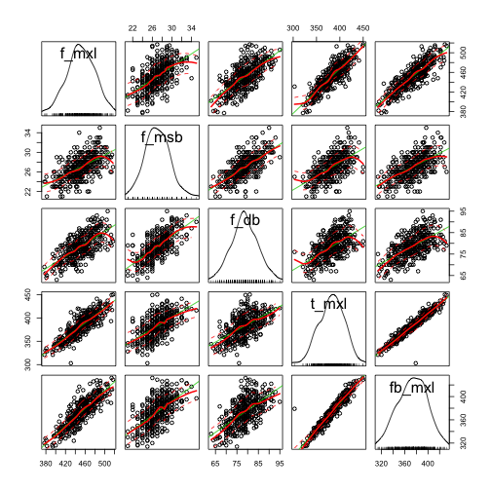
Scatterplots

Slide 54
Scatterplots
Scatterplot Matrices
Bi-variate scatter plots help you visualize relationships between two quantitative / continuous variables
When there are additional variables being explored you can use a scatterplot matrix
Helps identify outliers
Helps identify multicollinearity
Includes stats functions (linear and loess lines)
Can also incorporate boxplots / histograms / rug plots on diagonal

Slide 55
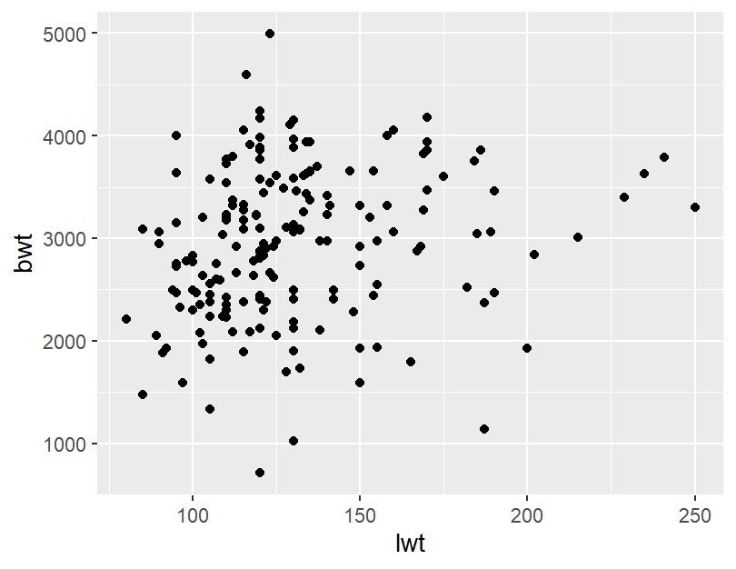
Scatterplots
> bw <- birthwt %>% select(age, lwt, smoke, bwt)
# create labelled factors
> unique(bw$smoke)
[1] 0 1
> bw$smoke <- factor(bw$smoke, levels=c(0,1), labels=c(“No", “Yes"))
# plot
> ggplot(bw, aes(x=lwt, y=bwt)) + geom_point()

Slide 56
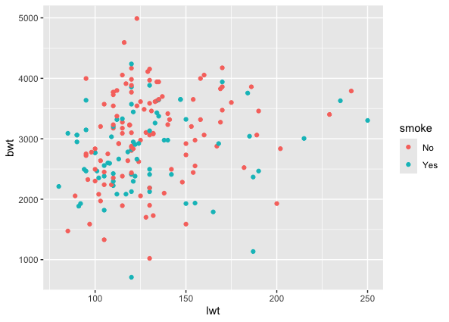
Scatterplots: Discrete Color
Color can be used to differentiate between discrete variables
# plot
> ggplot(bw, aes(x=lwt, y=bwt, color=smoke)) + geom_point()

Slide 57
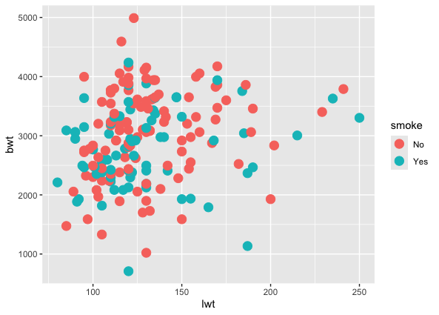
Scatterplots: Discrete Shapes
# plot
> ggplot(bw, aes(x=lwt, y=bwt, shape=smoke)) + geom_point(size=4)

Slide 58
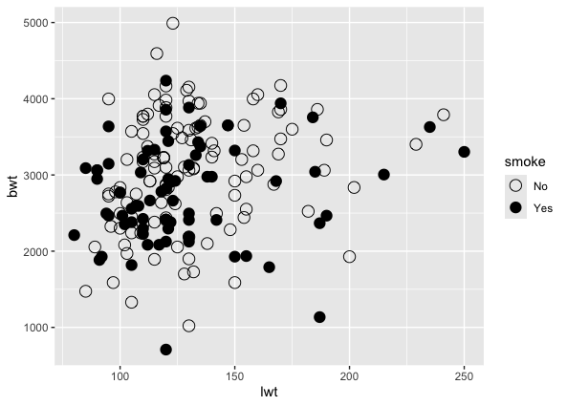
Scatterplots: Specifying Shape
scale_shape_manual() is used to specify the values of the pch
# plot
> ggplot(bw, aes(x=lwt, y=bwt, shape=smoke)) + geom_point(size=4) + scale_shape_manual(values=c(1,16))

Slide 59
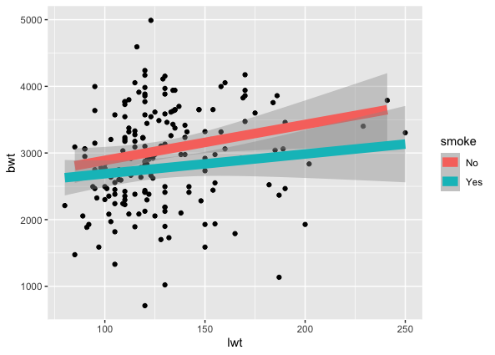
Scatterplots: Adding a Stat Line
stat_smooth() is used to add a line which represents the statistical procedure specified by the “method” argument
> ggplot(bw, aes(x=lwt, y=bwt)) + geom_point(size=4) +
stat_smooth(aes(color=smoke), method=lm, lwd=4)

Slide 60
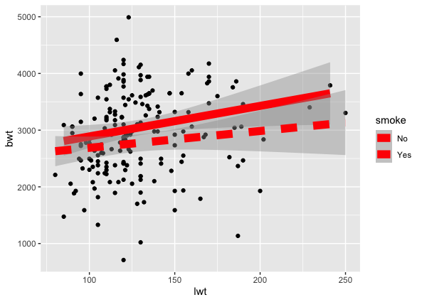
Scatterplots: Adding a Stat Line
We can also differentiate between lines using linetype
> ggplot(bw, aes(x=lwt, y=bwt)) + geom_point(size=4) +
stat_smooth(aes(lty=smoke), method=lm, lwd=4, color="red"))

Slide 61
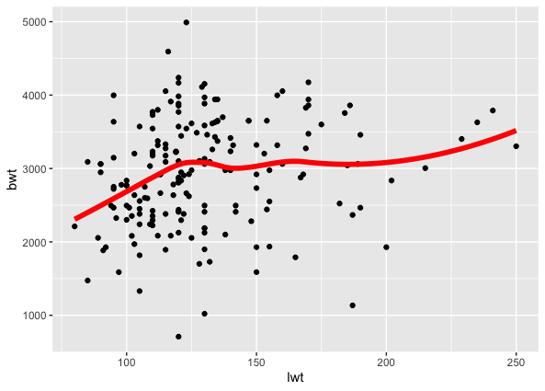
geom_smooth()
geom_smooth() adds a loess smoothing line to our plot
Loess = Locally Estimated Scatterplot Smoothing
> ggplot(bw, aes(x=lwt, y=bwt)) + geom_point(size=4) +
geom_smooth(se=FALSE, lwd=2, color="red")

Slide 62
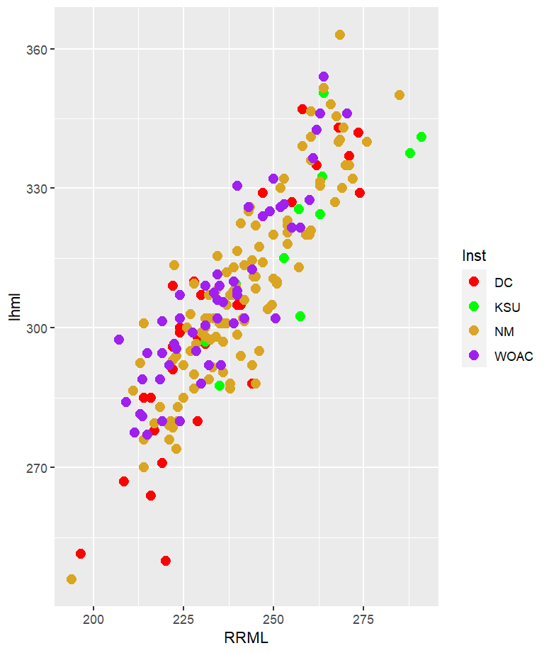
Practice
Produce this plot
Use the following code to transform your data:
> pc <- goldman_pc %>% select(Inst, lhml, RRML) %>%
filter(Inst %in% c('DC', 'KSU', 'NM', 'WOAC')) %>% na.omit()
Hint:
Use scale_color_manual() to specify color values of: “red”, “green”, “goldenrod”, “purple”
Point size = 3
Goldman_pc is in your data folder.

Slide 63
Answer
> ggplot(pc, aes(x=RRML, y=lhml, color=Inst)) + geom_point(size=3) + scale_color_manual(values=c("red","green", "goldenrod","purple"))

Slide 64
Labels and Titles
If the previous plot is assigned to the object name example_plot, we can use labs() to change the plot labels
> example_plot <- ggplot(pc, aes(x=RRML, y=lhml, color=Inst)) + geom_point(size=3) + scale_color_manual(values=c("red","green","goldenrod", "purple"))
> example_plot <- example_plot + labs(x="Radius max. length", y="Humerus max. length", title="Scattered", color="Institution")

Slide 65
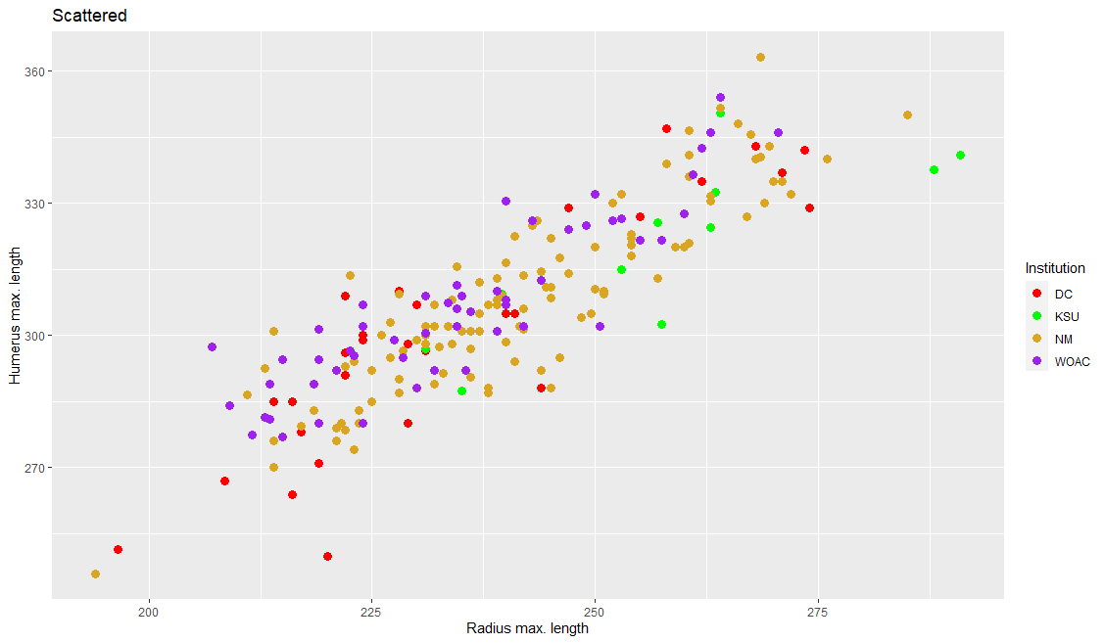
Labels and Titles

Slide 66
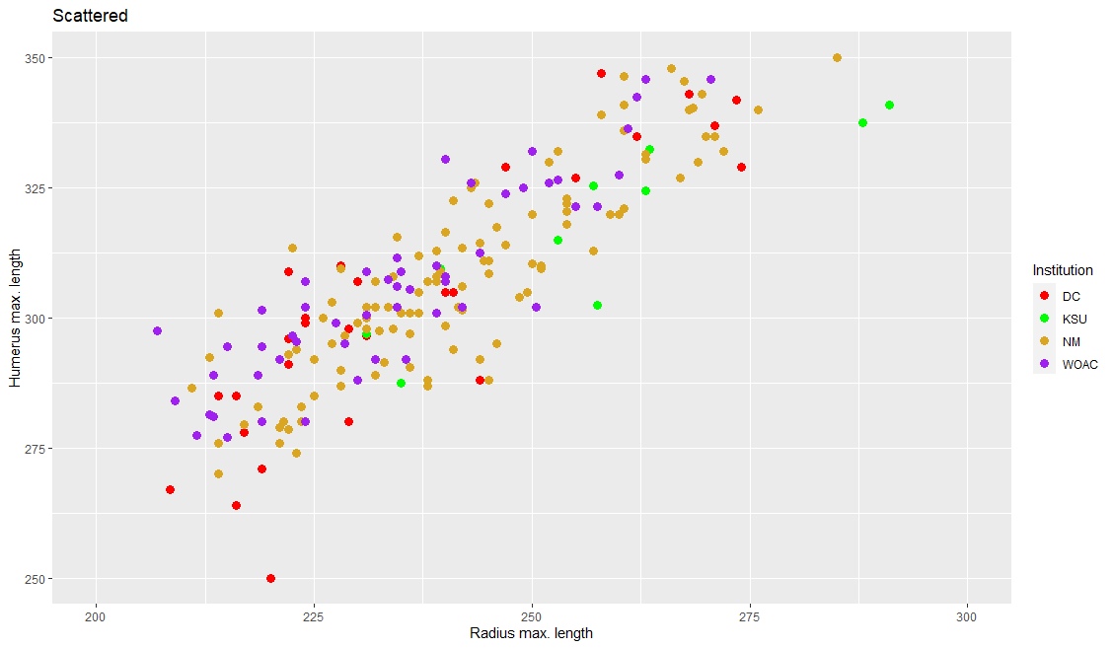
Axes
xlim() and ylim() are added to specify the range of the axes
> example_plot <- example_plot + xlim(200, 300) + ylim(250, 350)

Slide 67
Themes
Themes are used to adjust the visual appearance of elements in your plot
There are 4 element types:
element_blank()*
element_line()
element_rect()
element_text()*
*Notes:
element_blank() is used to remove a specified element from the plot
element_text() is the most used

Slide 68
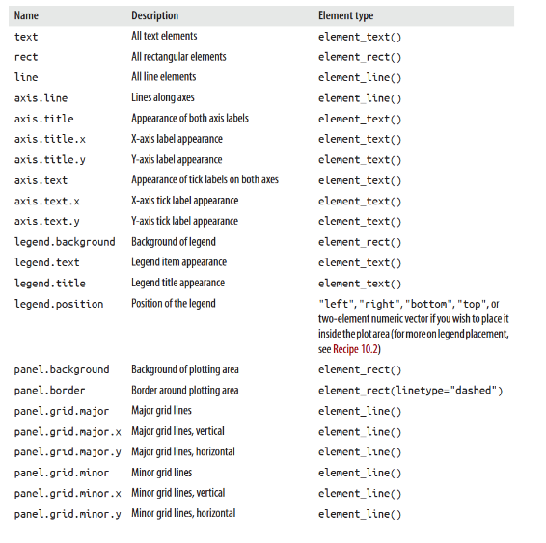
Theme Options
> plot + theme_bw() + theme(axis.title.x = element_text(colour="red", size=12))

Slide 69
element_text()
element_text() is used to change fonts, sizes, justification, angles, and more
help(element_text()) for more options
TIP: Load ggplot2 and type help(theme) for all theme elements
> theme(title=element_text(size=16)
> theme(plot.title=element_text(size=22)
> theme(axis.title=element_text(size=16)
> theme(axis.text=element_text(size=12)
> theme(legend.text=element_text(size=12)

Slide 70
Pre-Made Themes
library(ggplot2) comes with several premade themes and library(ggthemes) includes many more… go explore!
Premade themes are functions and are called by the code: > my_plot + theme_bw()
These themes are often good starting points for creating a custom theme

Slide 71
Custom Theme
elaine_theme <- theme_bw() + theme(panel.grid.major=element_blank(), panel.grid.minor=element_blank(), legend.background=element_blank(), legend.box.background=element_rect(color='black'), legend.key=element_blank(), legend.title=element_text(face='plain',size=14), legend.text=element_text(size=12), axis.title=element_text(size=15, lineheight=.9, vjust=.3), axis.text=element_text(size=12), axis.title.x=element_text(vjust=.2), axis.title.y=element_text(vjust=.3), plot.title=element_text(size=18), strip.text=element_text(size=12))

Slide 72
Custom Theme
elaine_theme <- theme_bw() + theme(panel.grid.major=element_blank(), panel.grid.minor=element_blank(), legend.background=element_blank(), legend.box.background=element_rect(color='black'), legend.key=element_blank(), legend.title=element_text(face='plain',size=14), legend.text=element_text(size=12), axis.title=element_text(size=15, lineheight=.9, vjust=.3), axis.text=element_text(size=12), axis.title.x=element_text(vjust=.2), axis.title.y=element_text(vjust=.3), plot.title=element_text(size=18), strip.text=element_text(size=12))

Slide 73
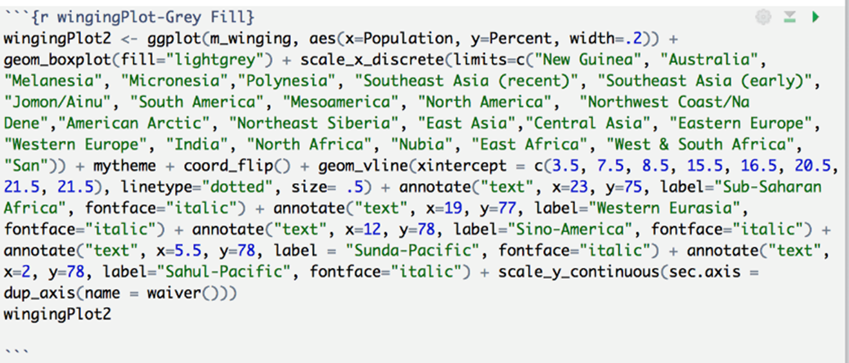
How big can visualizations code get???

Slide 74
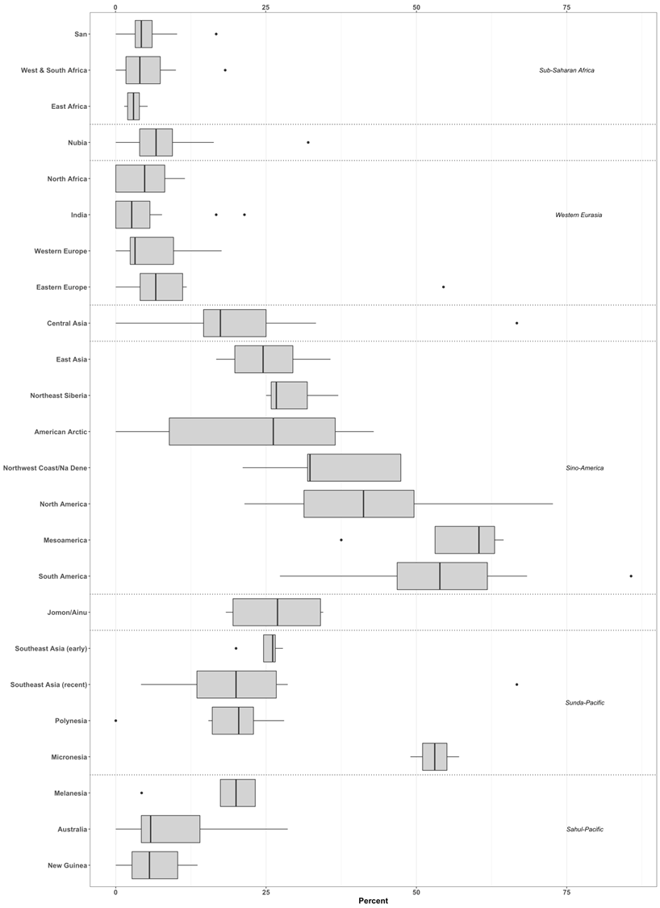

Slide 75
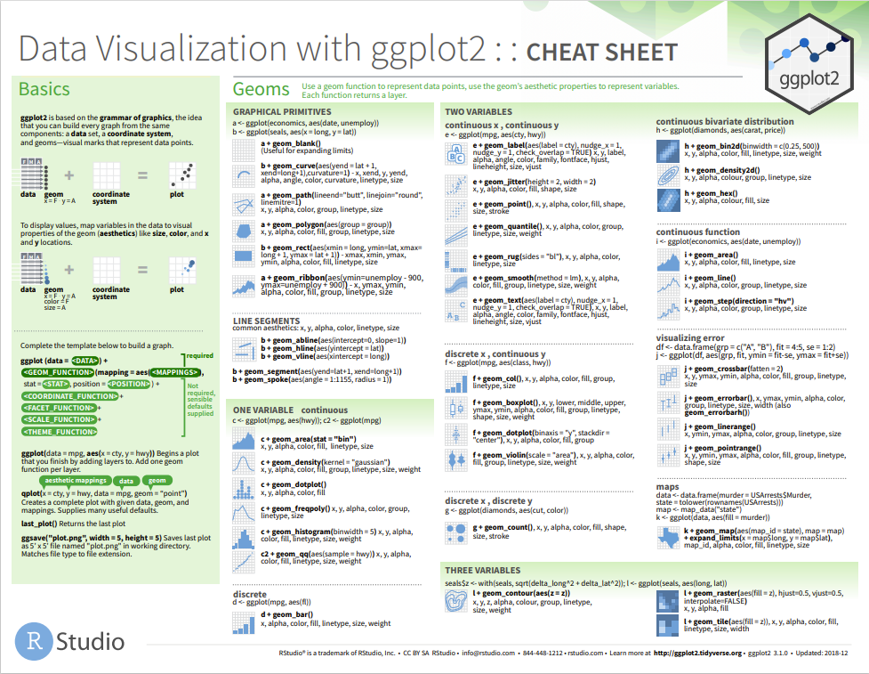
CHEATSHEET:
data-visualization -2.1.pdf

